Slide 1

MICROCONTROLLERS PROJECT THERMOSTAT CIRCUIT DESIGN

Slide 2
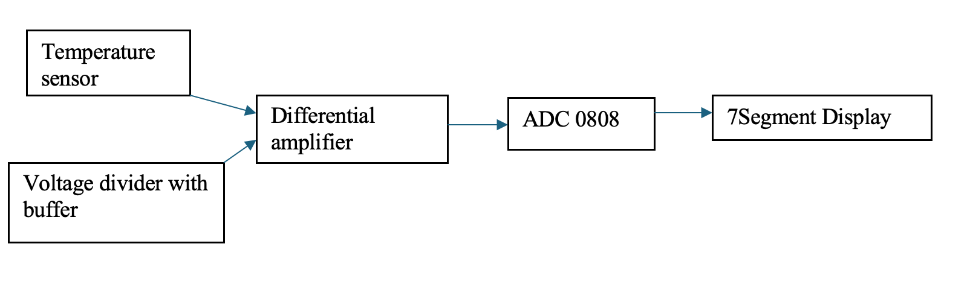
1.Block Scheme

Slide 3
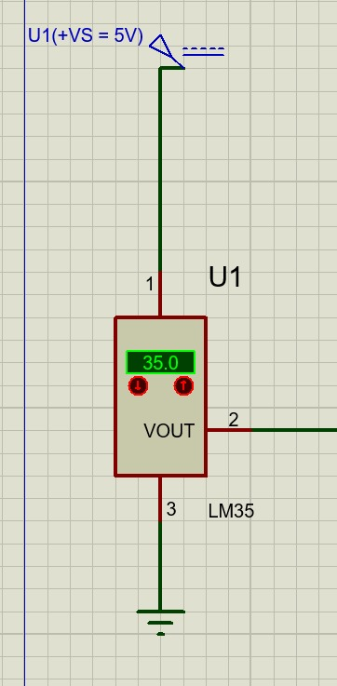
2.The temperature sensor
LM35,sensor chosen and explained last presentation, implemented in Proteus.

Slide 4
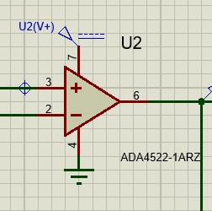
2.The amplifier
ADA4522
-rail to rail precision amplifier

Slide 5
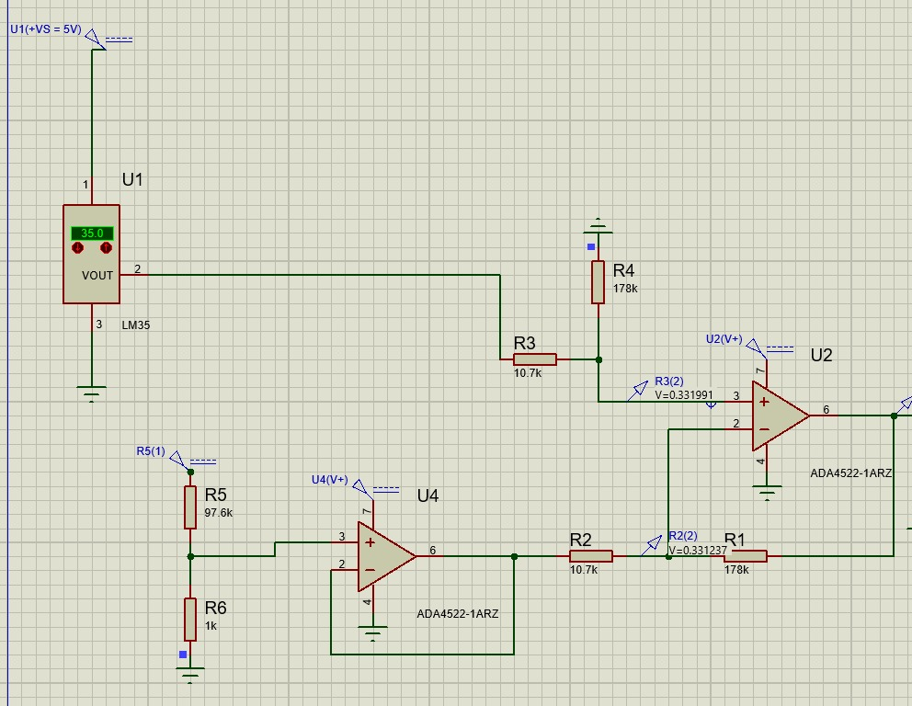
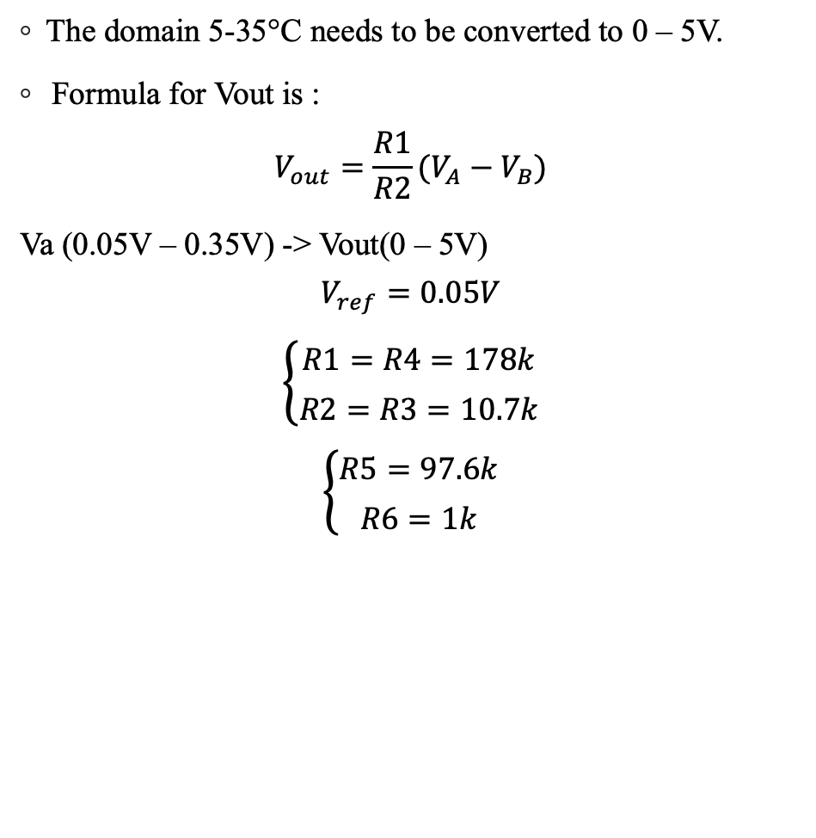
3.The differential amplifier
The domain 5-35°C needs to be converted to 0 – 5V.
Formula for Vout is :
$$V_{out}=\frac{R1}{R2}(V_{A}−V_{B})$$
Va (0.05V – 0.35V) -> Vout(0 – 5V)
$$V_{ref}=0.05V$$
$$\left\{\begin{aligned}R1=R4=178k \\ R2=R3=10.7k\end{aligned}\right.$$
$$\left\{\begin{aligned}R5=97.6k \\ R6=1k\end{aligned}\right.$$

Slide 6
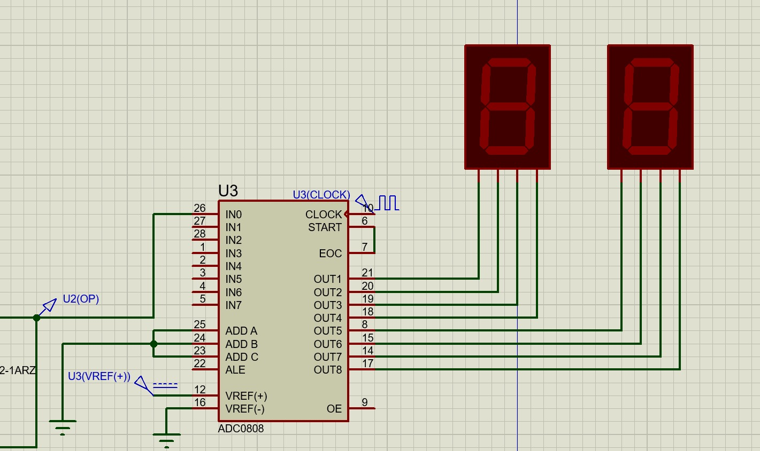
4.ADC0808
The ADC has a Successive Approximation Register that determines the digital output by performing a binary search to approximate the analog input voltage. To observe the output of the ADC I attached two 7Segments, one for each 4 bites. The results should be 00 for 5°C and FF for 35°C.

Slide 7
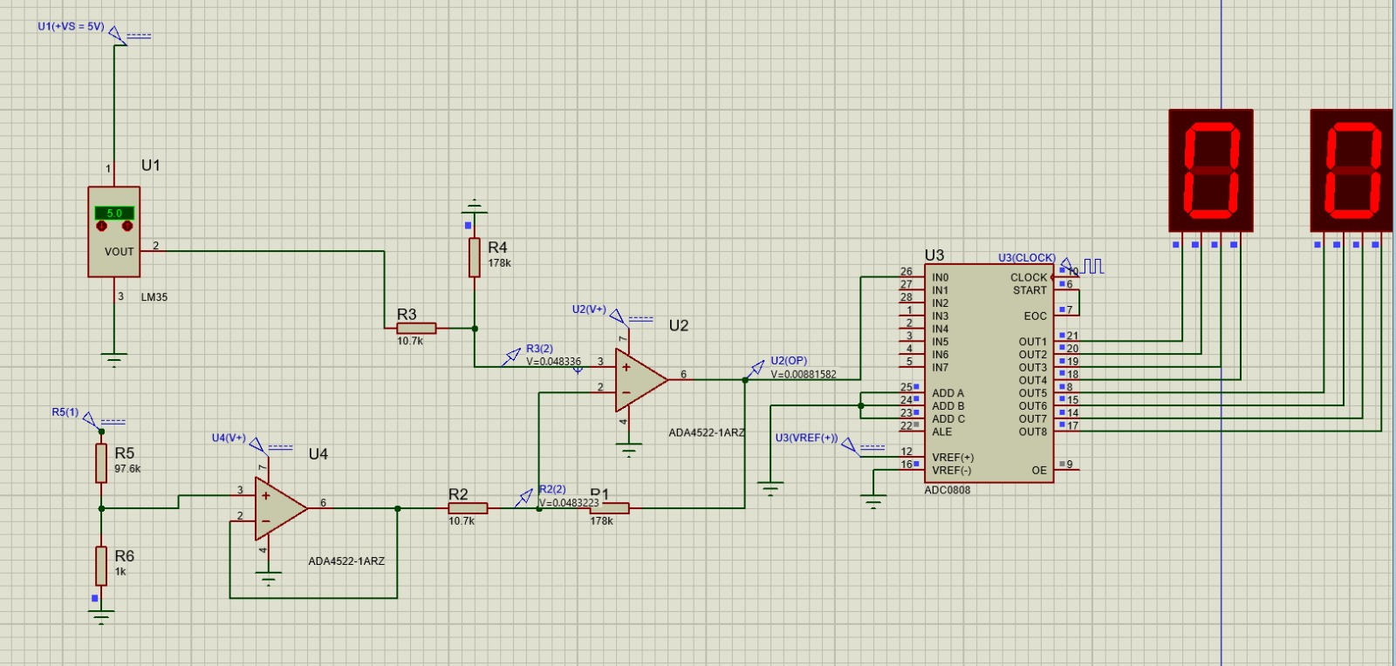
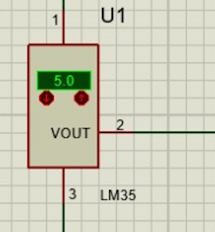
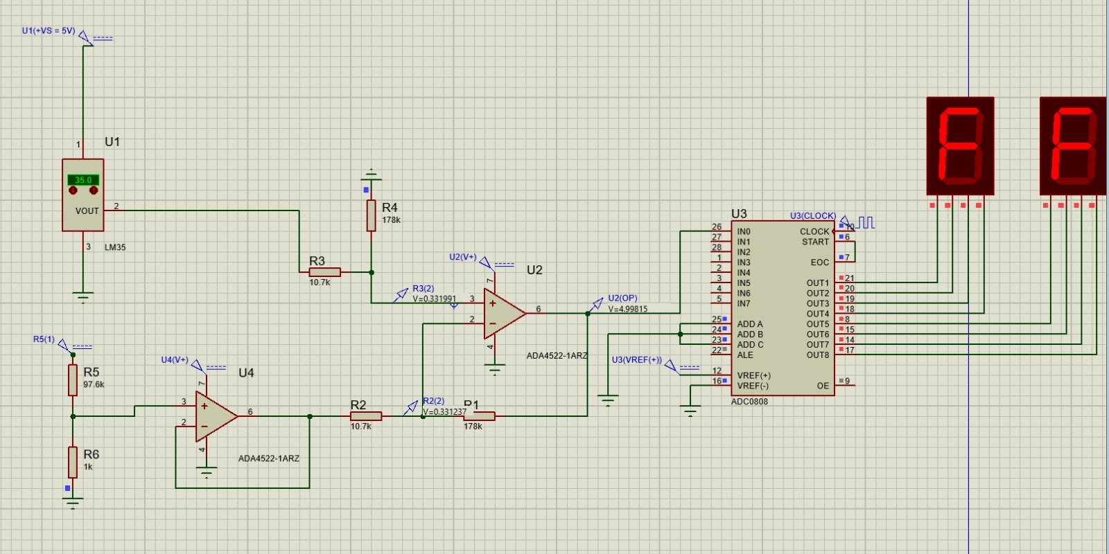
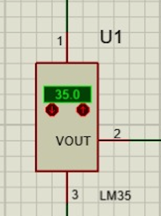
4.Verification

